Slide 1
Population and GDP in the US
Anthony Szabo

Slide 2
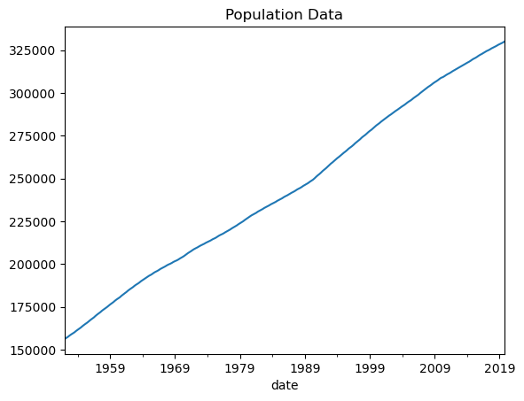
Population
The United States population affects the amount of:
Jobs
Houses/Apartments
Food

Slide 3
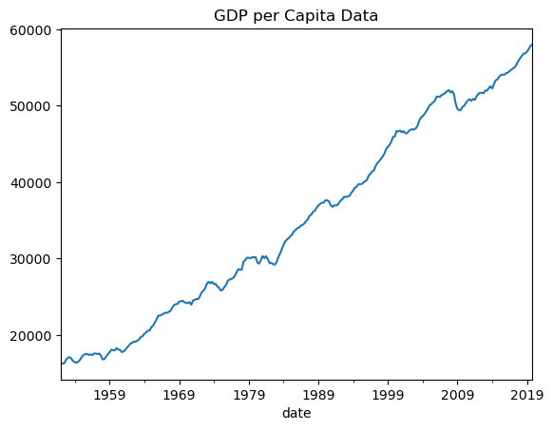
GDP per capita
The GDP per capita of the US reflects
Economic Stability
Economic Performance
Societal Spending

Slide 4
Our goal
We will be able to accurately predict the population and GDP per capita of the US through the end of 2029, and make decisions based on where those numbers are trending towards

Slide 5
Machine learning models used
ARIMA
Linear Regression
Linear Support Vector Regression
XGBoost Regression

Slide 6
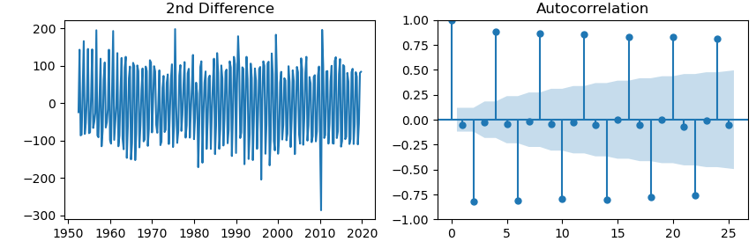
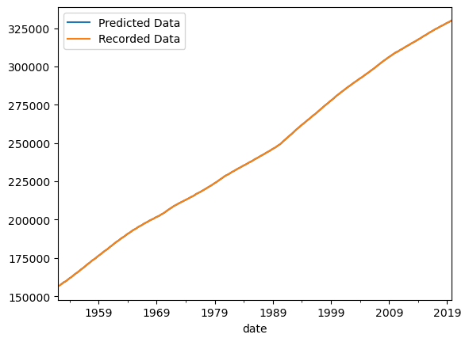
ARIMA for population data
Autocorrelation Function
The ARIMA model performed exceptionally well with the population data. It also showed no pattern between noise as time went on, nor significant seasonality.
RMSE: 35.98
Comparison

Slide 7
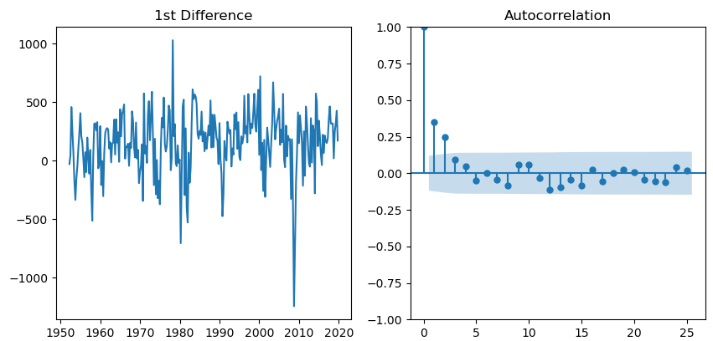
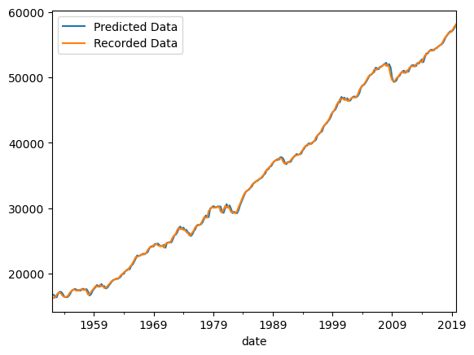
ARIMA for GDP per capita data
Autocorrelation Function
The ARIMA model once again performed very well with the GDP per capita data. Once again, no pattern of noise or significant seasonality were observed. We had a slightly higher RMSE, but that is to be expected with less linear data.
RMSE: 245.92
Comparison

Slide 8
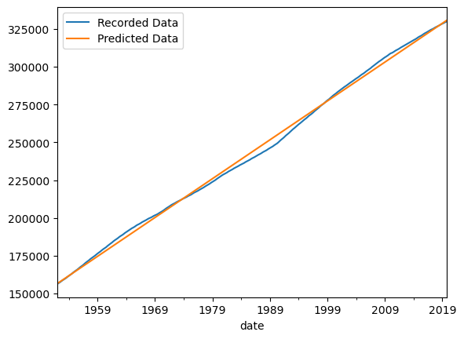
Linear Regression for population data
Comparison
The Linear Regression model showed fairly direct correlation between time and population. Though the population data does have this relationship, it’s RMSE is substantially higher than the ARIMA model.
RMSE: 2500.04

Slide 9
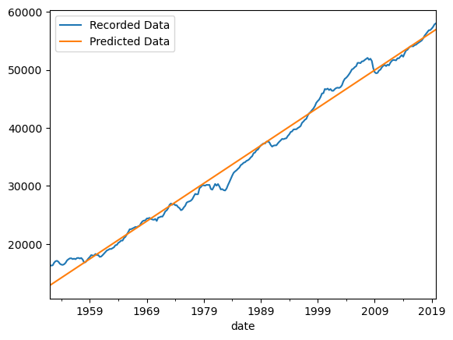
Linear Regression for gdp per capita data
Comparison
With the GDP per capita, we see a less linear relationship caused by significant historical events. The RMSE is, once again, much higher than that of the ARIMA model.
RMSE: 1439.24

Slide 10
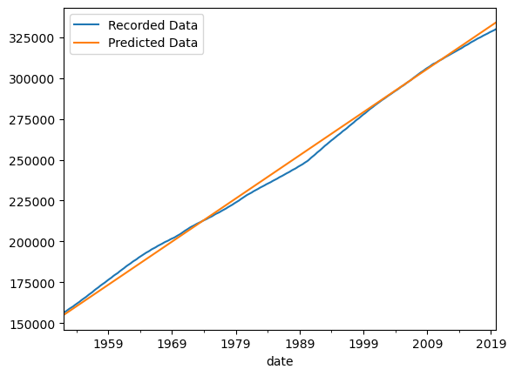
Linear svr for population data
Comparison
Linear SVR for the population data performed slightly worse than Linear Regression. This model performed the worst so far.
RMSE: 2958.63

Slide 11
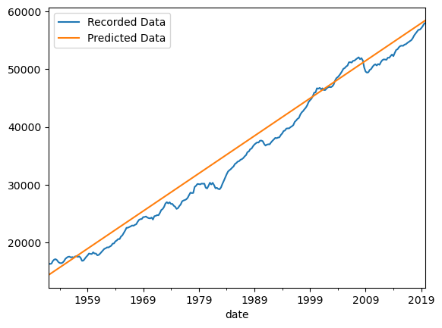
Linear svr for gdp per capita data
Comparison
Linear SVR for GDP data once again was the worst model in terms of RMSE, this time by almost 1000.
RMSE: 2427.16

Slide 12
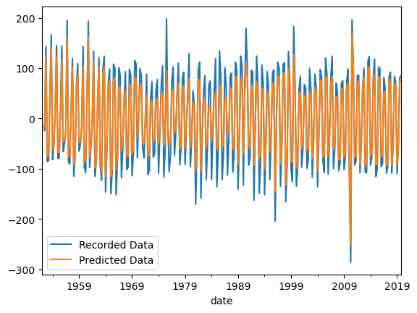
xgboost Regression for population data
Comparison
XGBoost Regression performed very well with the population data and showed the lowest RMSE yet, though it was using the stationary data.
RMSE: 29.54

Slide 13
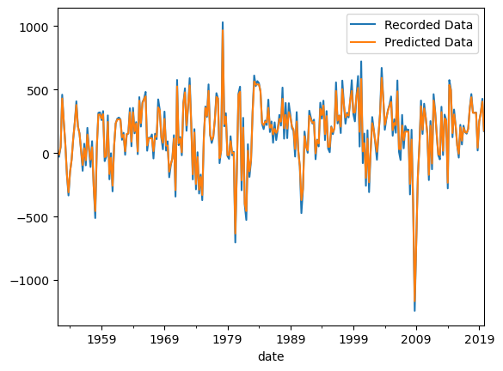
xgboost Regression for gdp per capita data
Comparison
We once again saw a new lowest RMSE with the XGBoost Regression and GDP per capita data.
RMSE: 38.98

Slide 14
Best models
Population
For both the population and GDP per capita data, the ARIMA model was our best model. Both showed incredibly low RMSE values given the original data and can make very accurate predictions.
GDP per Capita

Slide 15
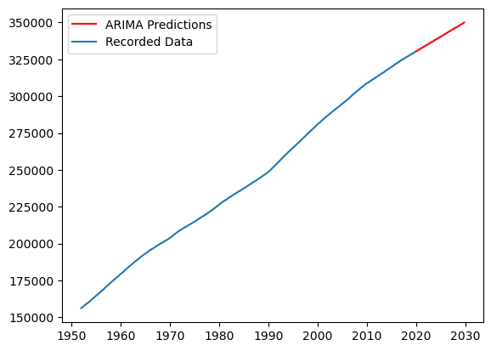
Population predictions
End of 2019: 330 million
End of 2029: 350 million
2010s: 21.7 million
2020s: 20 million

Slide 16
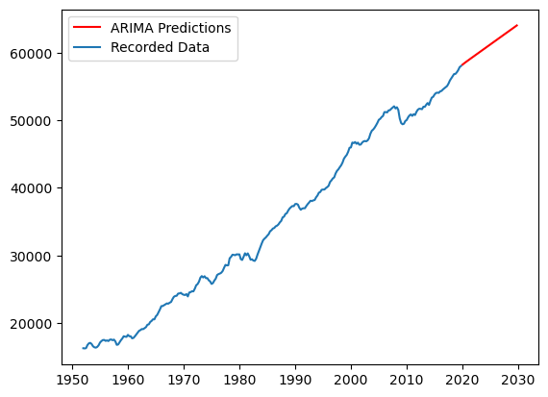
Gdp per capita predictions
End of 2019: 58,017
End of 2029: 64,011
2010s: 8,131
2020s: 5,994

Slide 17
Further research
Homelessness
Unemployment
Number of jobs
Cost of living

Slide 18
Thank you

